Slide 1
Huffman Coding: File Compression using Greedy Algorithm
Northeastern University | CS5800 Algorithms | Prof. Aida Sharif Rohani
By
Bhalchandra Shinde
Shantanu Wankhare

Slide 2

Huffman Coding
CS5800 Algorithms | Northeastern University
Introduction
Key Question.
How can we design a lossless compression system that significantly reduces text file size while enabling fast, real-time decompression for reading?
Huffman Tool
Reduce storage size without losing information.
Reader Application
Decode compressed data efficiently enough to display pages of a book on demand.

Slide 3
Huffman Coding
CS5800 Algorithms | Northeastern University
Context
Size
Digital text is produced and consumed at massive scale - ebooks, log, documents, research papers websites
Memory & Time
Storing and transferring large files is expensive
Redundancy
Traditional text formats uses uncompression. It has most words/char repeated
Compression
Efficient compression is needed for text files as well.

Slide 4
Huffman Coding
CS5800 Algorithms | Northeastern University
Encodings
File Type | Extensions | Existing Compression / Encoding Method | Is File Already Compressed? | Expected Huffman Compression Ratio | Explanation
Plain Text | .txt, .log, .csv, .json, .xml | None | ❌ No | 40% – 80% smaller | Text has skewed character frequency; Huffman is ideal.
Documents (Office XML) | .docx, .xlsx, .pptx | ZIP (DEFLATE: LZ77 + Huffman) | ✔ Already compressed | File becomes 20–200% larger | Office files are ZIP containers; content already compressed using Huffman + LZ.
PDF | .pdf | Flate/DEFLATE, LZW, JPEG, JP2 | ✔ Already compressed | +20% to +300% expansion | PDF streams already use entropy coding; random-like distribution.
Images (raw) | .bmp, .ppm, .tiff (uncompressed) | None (sometimes RLE for TIFF) | ❌ No | 30% – 70% smaller | Raw pixel data compresses fairly well.
Images (compressed) | .jpg, .jpeg | DCT + Quantization + Huffman | ✔ Yes | Huge expansion: 300% – 800% | JPEG already uses Huffman coding inside. Compressing again makes it worse.
Images (compressed) | .png | DEFLATE (LZ77 + Huffman) | ✔ Yes | Very large expansion: 200% – 600% | PNG uses entropy coding and filters; nearly incompressible.
Audio (raw) | .wav, .pcm, .aiff | None | ❌ No | 10% – 40% smaller | Raw amplitude distributions slightly skewed; small gains.
Audio (compressed) | .mp3, .aac, .flac | MP3: MDCT + Huffman / AAC: Huffman / FLAC: Rice/Huffman | ✔ Yes | Massive expansion: 300% – 1000% | Audio codecs already use Huffman coding internally.
Video (raw) | .yuv | None | ❌ No | 10% – 30% smaller | Pixel values partly skewed; limited improvement.
Video (compressed) | .mp4, .mov, .mkv, .avi | H.264/HEVC/AV1 (CABAC, CAVLC, entropy coding) | ✔ Yes | Very large expansion: 200% – 800% | These codecs use advanced entropy coding more efficient than Huffman.
Python/Source Code | .py, .java, .cpp, .html, .css, .js | None | ❌ No | 30% – 70% smaller | High redundancy and repeated keywords; good for Huffman.
Binary Executables | .exe, .dll, .bin | Often packed or randomized | ⚠️ Sometimes | Likely expansion: 20% – 500% | Binaries include many random bytes or pre-packed segments.
Archives | .zip, .7z, .rar, .gz, .whl | DEFLATE, LZMA, PPMD | ✔ Fully compressed | Always expands | These formats already use Huffman, arithmetic coding, or LZ — cannot compress again.

Slide 5
Huffman Coding
CS5800 Algorithms | Northeastern University
Rationale
Huffman Coding is a classic Greedy Algorithm that produces an optimal prefix-free encoding based on symbol frequencies.
It is widely used in real systems (ZIP, JPEG, MP3), but classroom examples rarely show practical applications.
This project extends the Huffman algorithm beyond theory, building a complete working system:
A compression tool
A decompression module
A chunk-based paging system
A Python Tkinter based book reader
Why this matters:
Demonstrates how algorithmic theory can be used to build a real application.
Highlights trade-offs in designing usable compression systems (speed, memory, chunking, file formats).

Slide 6
Huffman Coding
CS5800 Algorithms | Northeastern University
Analysis - Word level?
Character-level Huffman coding compresses but leaves redundancy: "the", "and", "to", "of" appear thousands of times.
Word-level encoding:
Dramatically reduces redundancy
Produces shorter average codewords
Improves readability after decoding
Works perfectly for book-style text
Compression improvement observed:
Word-level coding achieved up to 70% space savings vs raw .txt.

Slide 7
Huffman Coding
CS5800 Algorithms | Northeastern University
Context
01
02
03
Compression Module
Decompression Module
Reader Application
- Char or Word level tokenization
- Build Huffman tree as png file
- Encode and pack bits
- Generate metadata file for decoding
- Unpack bits
- Reconstruct Huffman trees
- Decode text create a text file
- Merge words into a continuous sequence
- Paginate decoded text (≈250 words/page)
- Tkinter GUI
- Navigation, big font layout, page numbering

Slide 8
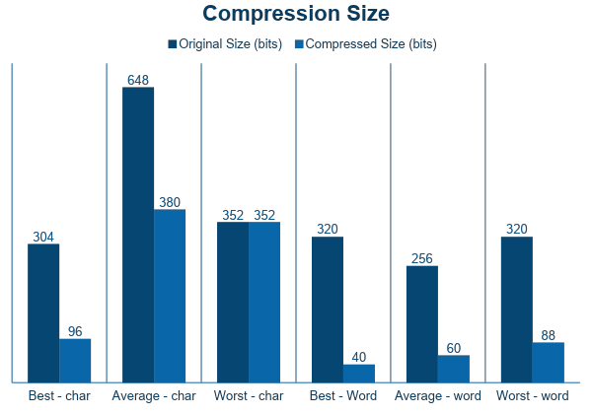
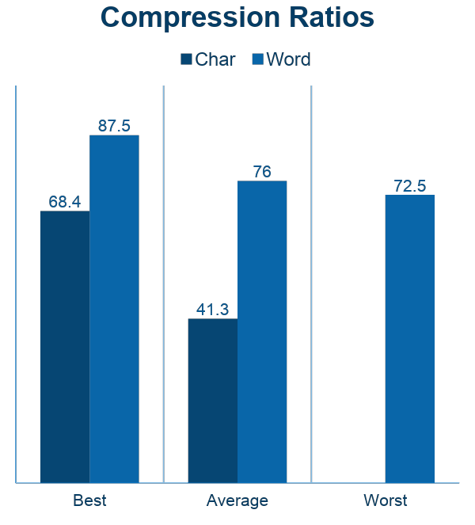
Huffman Coding
CS5800 Algorithms | Northeastern University
Test Results

Slide 9
Huffman Coding
CS5800 Algorithms | Northeastern University
Huffman.py
encode()
├── build_frequency_table()
├── build_huffman_tree()
│ ├── create Node for each symbol
│ ├── heapq.heappush()
│ ├── heapq.heappop()
│ ├── merge two smallest nodes
│ └── return root
├── generate_codes(root)
│ ├── DFS traversal
│ ├── prefix + '0' for left
│ └── prefix + '1' for right
├── calculate compressed bits
├── write codebook summary file
└── return (encoded_bitstring, freq_table)
compress_file(file_path, mode)
Steps:
├── Read input file
├── Instantiate HuffmanCoding() object
├── Call → encode(text, code_output_path, mode)
├── write encoded data → compress_<file>.huff
├── write freq table → compress_<file>.huff.freq.json
├── visualize_tree(root) ← optional
│ ├── Graphviz Digraph OR Custom Matplotlib
│ └── save PNG image
└── return success

Slide 10
Huffman Coding
CS5800 Algorithms | Northeastern University
Huffman tool
Python Tkiner GUI
Paper like reading experience
Chunks of 250 words decoded per page
Page Navigation controls
Load any book with .huff and .json metadata file

Slide 11
Huffman Coding
CS5800 Algorithms | Northeastern University
Reader - pseudocode
CHUNKED-HUFFMAN-COMPRESS(Text, PAGE_SIZE)
words = split Text into tokens
chunks = group words into PAGE_SIZE blocks
outputBinaries = empty
metadata = empty list
for each chunk:
freq = frequency count(chunk)
tree = build Huffman tree(freq)
codes = generate codes(tree)
encodedBits = concat(codes[word] for word in chunk)
packedBytes, padding = pack_into_bytes(encodedBits)
append packedBytes to output file
store in metadata: offset, length, padding, freq
write metadata.json
Inputs
book.txt — raw book
book.txt.huff — compressed binary
book.txt.huff.freq.json — chunk metadata
Chunk sizes, padding values, frequency tables
Outputs
Decoded individual pages
Page count
Compression ratio
Memory-efficient reading of entire text
CHUNKED-HUFFMAN-DECODE(file.huff, metadata)
for each chunkInfo in metadata:
bytes = read chunk from file
bitstring = unpack_bytes(bytes, chunkInfo.padding)
tree = rebuild Huffman tree(chunkInfo.freq)
decodedWords += decode_bits_using_tree(bitstring, tree)
return decodedWords

Slide 12
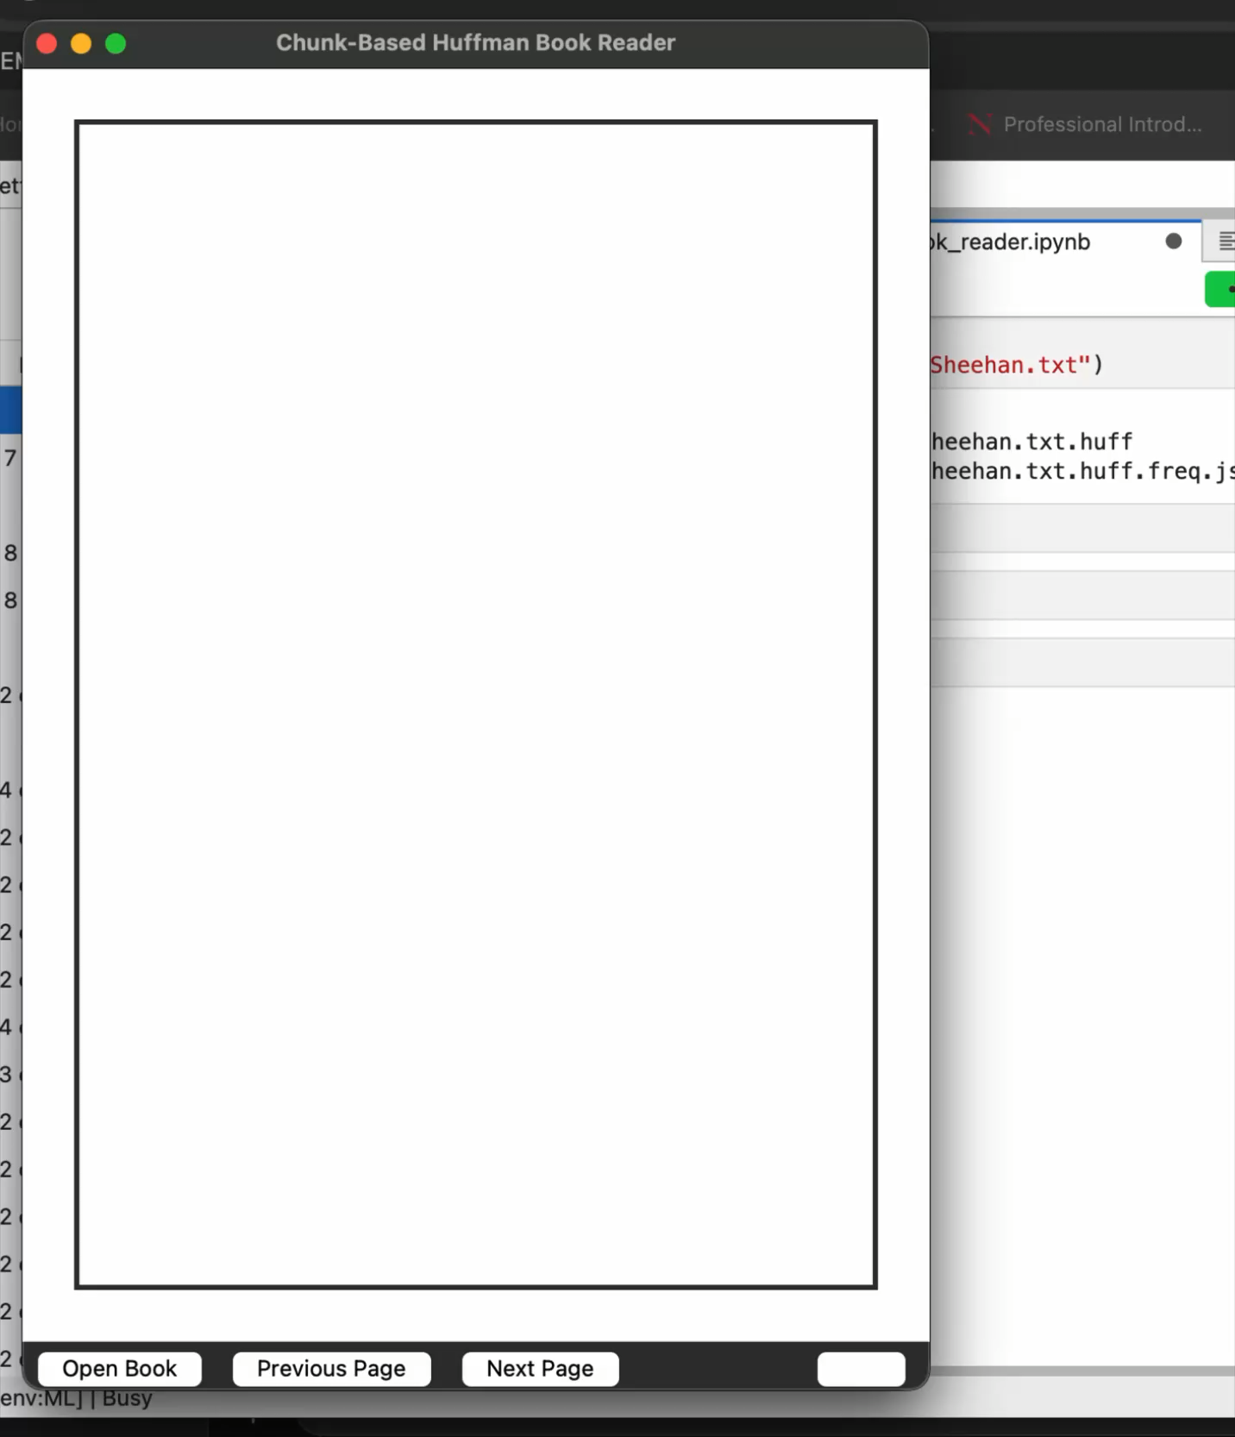
Huffman Coding
CS5800 Algorithms | Northeastern University
Reader application
Python Tkinter GUI
Paper like reading experience
Chunks of 250 words decoded per page
Page Navigation controls
Load any book with .huff and .json metadata file

Slide 13
Huffman Coding
CS5800 Algorithms | Northeastern University
Observations
More repetition → better compression
Huffman coding efficiency depends on frequency distribution
Worst-case for char: no gain, overhead may slightly increase size
Visual tree helps understand code assignment
Huffman Coding is not just theoretical, it powers real systems.
This project demonstrates complete integration from algorithm → compression → metadata → decoding → UI.
Shows how algorithm design, data structures and UX can combine to produce a working, practical application.

Slide 14
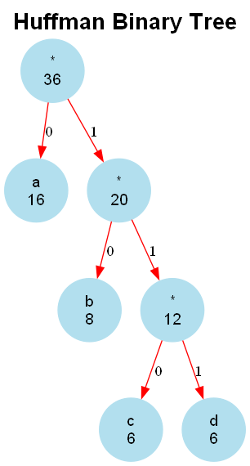
Huffman Coding
CS5800 Algorithms | Northeastern University
Best Case Char
Best case Example: "aaaaaaaaaaaaaaaabbbbbbbbccccccdddddd”
Huffman Encoding Report (Character-Level)
Original Text Length: 36 tokens
Symbol Table:
Symbol | Frequency | Huffman Code | Bits Used
=================================================
a | 16 | 0 | 16
b | 8 | 10 | 16
c | 6 | 110 | 18
d | 6 | 111 | 18
=================================================
Original size (bits): 288
Compressed size (bits): 68
Compression ratio: 76.39%
Unique symbols: 4
Most frequent symbol: 'a' (16 times)
Least frequent symbol: 'c' (6 times)

Slide 15
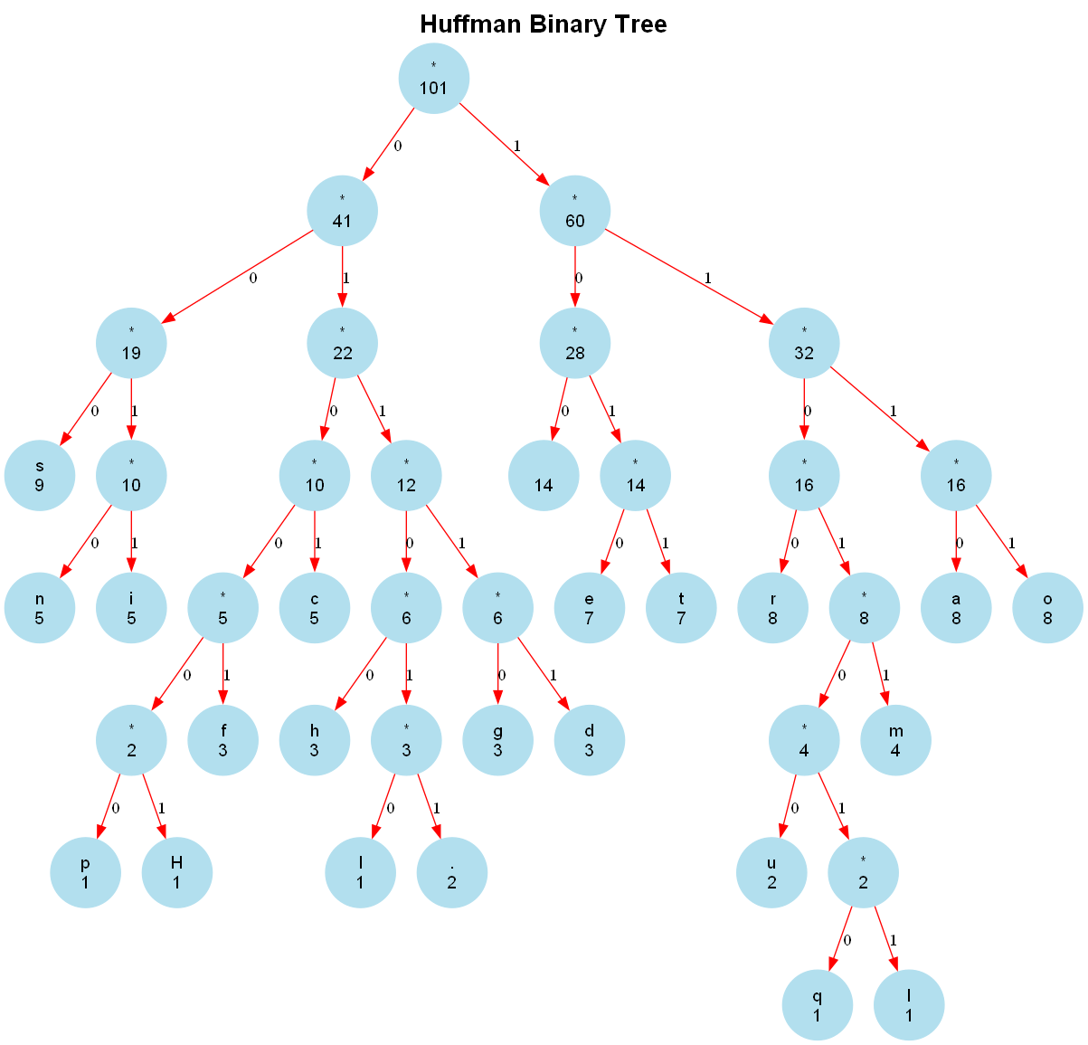
Huffman Coding
CS5800 Algorithms | Northeastern University
Average Case Char
Average case Example: "Huffman coding is a data compression algorithm. It assigns shorter codes to more frequent characters.”
Huffman Encoding Report (Character-Level)
Original Text Length: 101 tokens
Symbol Table:
Symbol | Frequency | Huffman Code | Bits Used
============================================================
s | 9 | 000 | 27
n | 5 | 0010 | 20
i | 5 | 0011 | 20
p | 1 | 010000 | 6
H | 1 | 010001 | 6
f | 3 | 01001 | 15
c | 5 | 0101 | 20
h | 3 | 01100 | 15
l | 1 | 011010 | 6
. | 2 | 011011 | 12
g | 3 | 01110 | 15
d | 3 | 01111 | 15
' ' | 14 | 100 | 42
e | 7 | 1010 | 28
t | 7 | 1011 | 28
r | 8 | 1100 | 32
u | 2 | 110100 | 12
q | 1 | 1101010 | 7
I | 1 | 1101011 | 7
m | 4 | 11011 | 20
a | 8 | 1110 | 32
o | 8 | 1111 | 32
============================================================
Original size (bits): 808
Compressed size (bits): 417
Compression ratio: 48.39%
Unique symbols: 22
Most frequent symbol: ' ' (14 times)
Least frequent symbol: 'H' (1 times)

Slide 16
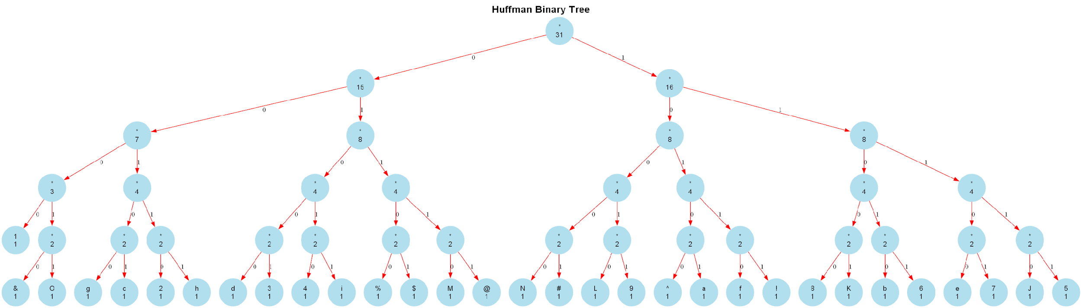
Huffman Coding
CS5800 Algorithms | Northeastern University
Worst Case Char
Huffman Encoding Report (Character-Level)
Original Text Length: 31 tokens
Symbol Table:
Symbol | Frequency | Huffman Code | Bits Used
===========================================
1 | 1 | 0000 | 4
& | 1 | 00010 | 5
O | 1 | 00011 | 5
g | 1 | 00100 | 5
c | 1 | 00101 | 5
2 | 1 | 00110 | 5
h | 1 | 00111 | 5
d | 1 | 01000 | 5
3 | 1 | 01001 | 5
4 | 1 | 01010 | 5
i | 1 | 01011 | 5
% | 1 | 01100 | 5
$ | 1 | 01101 | 5
M | 1 | 01110 | 5
6 | 1 | 11011 | 5
@ | 1 | 01111 | 5
N | 1 | 10000 | 5
# | 1 | 10001 | 5
L | 1 | 10010 | 5
9 | 1 | 10011 | 5
^ | 1 | 10100 | 5
a | 1 | 10101 | 5
f | 1 | 10110 | 5
! | 1 | 10111 | 5
8 | 1 | 11000 | 5
K | 1 | 11001 | 5
b | 1 | 11010 | 5
6 | 1 | 11011 | 5
e | 1 | 11100 | 5
7 | 1 | 11101 | 5
J | 1 | 11110 | 5
5 | 1 | 11111 | 5
==================================================
Original size (bits): 248
Compressed size (bits): 154
Compression ratio: 37.90%
Unique symbols: 31
Most frequent symbol: 'a' (1 times)
Least frequent symbol: 'a' (1 times)
Worst case Example: "abcdefghiJKLMNO123456789!@#$%^&”

Slide 17
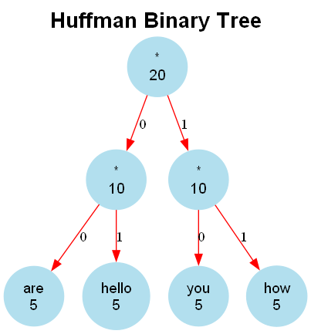
Huffman Coding
CS5800 Algorithms | Northeastern University
Best Case Word
Best case Example: "hello how are you hello how are you hello how are you hello how are you hello how are you”
Huffman Encoding Report (Word-Level)
Original Text Length: 20 tokens
Symbol Table:
Symbol | Frequency | Huffman Code | Bits Used
=====================================================
are | 5 | 00 | 10
hello | 5 | 01 | 10
you | 5 | 10 | 10
how | 5 | 11 | 10
=====================================================
Original size (bits): 320
Compressed size (bits): 40
Compression ratio: 87.50%
Unique symbols: 4
Most frequent symbol: 'hello' (5 times)
Least frequent symbol: 'hello' (5 times)

Slide 18
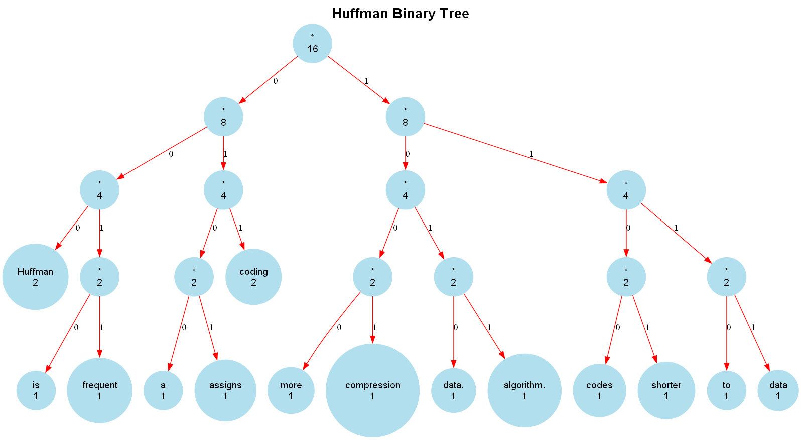
Huffman Coding
CS5800 Algorithms | Northeastern University
Average Case Word
Best case Example: "Huffman coding is a data compression algorithm.
Huffman coding assigns shorter codes to more frequent data.”
Huffman Encoding Report (Word-Level)
Original Text Length: 16 tokens
Symbol Table:
Symbol | Frequency | Huffman Code | Bits Used
======================================================
Huffman | 2 | 000 | 6
is | 1 | 0010 | 4
frequent | 1 | 0011 | 4
a | 1 | 0100 | 4
assigns | 1 | 0101 | 4
coding | 2 | 011 | 6
more | 1 | 1000 | 4
compression | 1 | 1001 | 4
data. | 1 | 1010 | 4
algorithm. | 1 | 1011 | 4
codes | 1 | 1100 | 4
shorter | 1 | 1101 | 4
to | 1 | 1110 | 4
data | 1 | 1111 | 4
======================================================
Original size (bits): 256
Compressed size (bits): 60
Compression ratio: 76.56%
Unique symbols: 14
Most frequent symbol: 'Huffman' (2 times)
Least frequent symbol: 'is' (1 times)

Slide 19
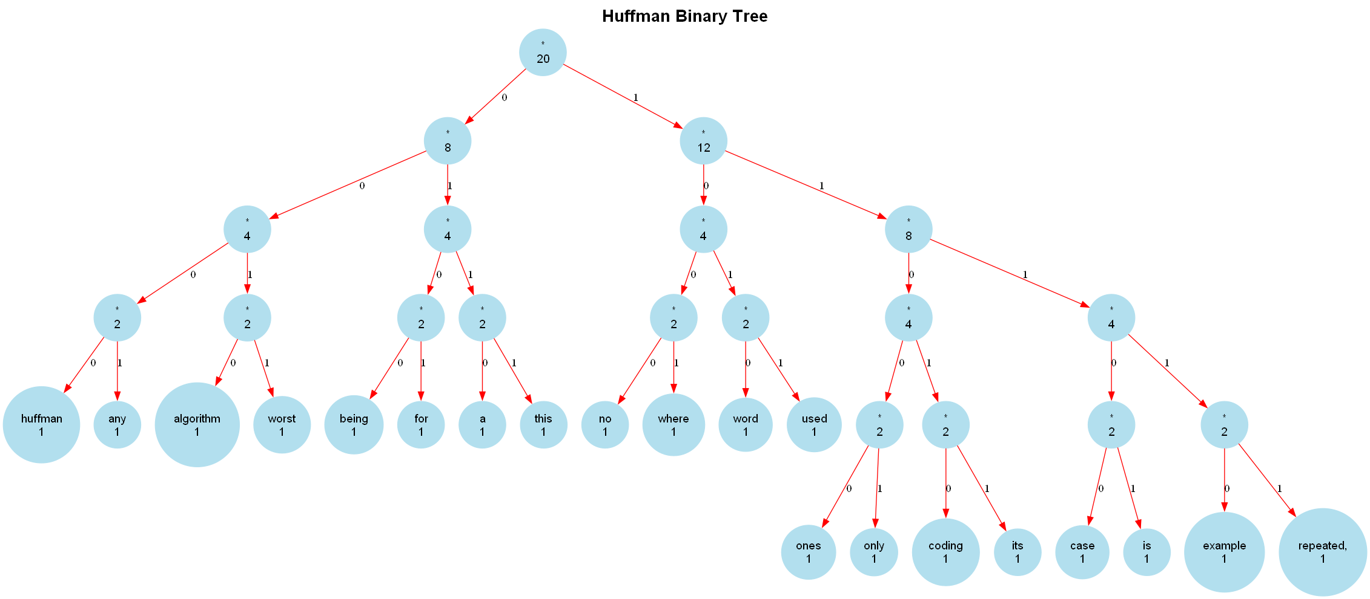
Huffman Coding
CS5800 Algorithms | Northeastern University
Worst Case Word
Huffman Encoding Report (Word-Level)
Original Text Length: 20 tokens
Symbol Table:
Symbol | Frequency | Huffman Code | Bits Used
====================================================
huffman | 1 | 0000 | 4
any | 1 | 0001 | 4
algorithm | 1 | 0010 | 4
worst | 1 | 0011 | 4
being | 1 | 0100 | 4
for | 1 | 0101 | 4
a | 1 | 0110 | 4
this | 1 | 0111 | 4
no | 1 | 1000 | 4
where | 1 | 1001 | 4
word | 1 | 1010 | 4
used | 1 | 1011 | 4
ones | 1 | 11000 | 5
only | 1 | 11001 | 5
coding | 1 | 11010 | 5
its | 1 | 11011 | 5
case | 1 | 11100 | 5
is | 1 | 11101 | 5
example | 1 | 11110 | 5
repeated, | 1 | 11111 | 5
====================================================
Original size (bits): 320
Compressed size (bits): 88
Compression ratio: 72.50%
Unique symbols: 20
Most frequent symbol: 'this' (1 times)
Least frequent symbol: 'this' (1 times)
Worst case Example: "this is a worst case example for huffman coding
algorithm where no any word being repeated, its used only ones”

Slide 20




Huffman Coding
CS5800 Algorithms | Northeastern University
Conclusion
Implemented system
Reduces storage usage substantially
Correctly reconstructs text
Ensures fast page loading
Works well across multiple books
Huffman Coding is not just theoretical, it powers real systems
This project demonstrates complete integration from algorithm → compression → metadata → decoding → UI.
Shows how algorithm design, data structures and UX can combine to produce a working, practical application.

Slide 21
T H A N K Y O U

